Slide 1
InstaTalk
202135781 Seo Jiho

Slide 2

Contents
Contents
1
2
3
1. Architecture
2. Story line of Program
3. Reference

Slide 3
1. Architecture

Slide 4




1. Structure
Server-Client
JDBC
DATABASE(MYSQL)
SERVER

Slide 5
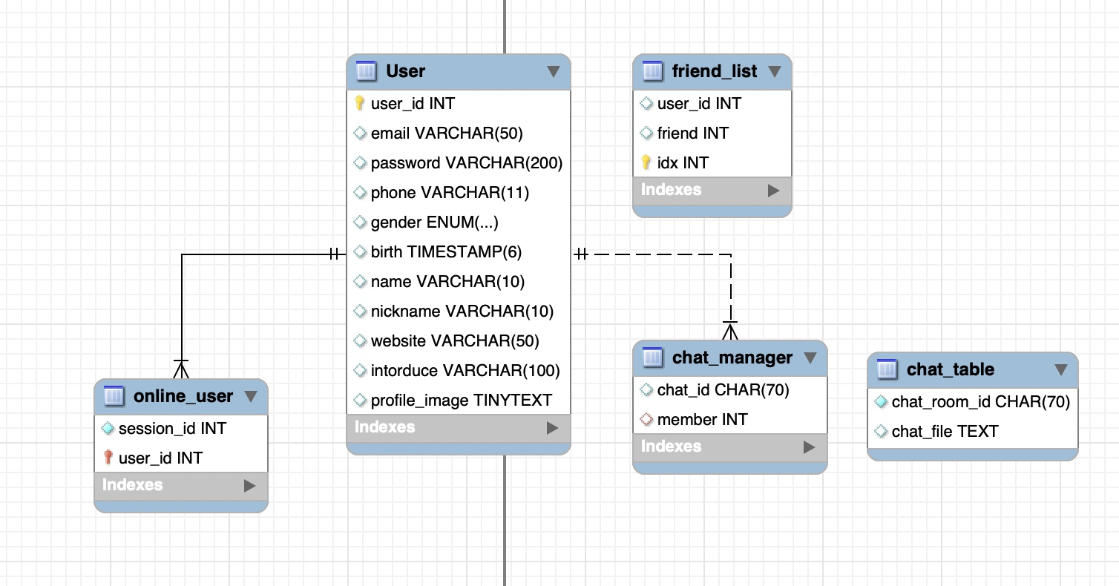
1-2. Database Schema
Database Schema Design -> Chatting Room Management

Slide 6
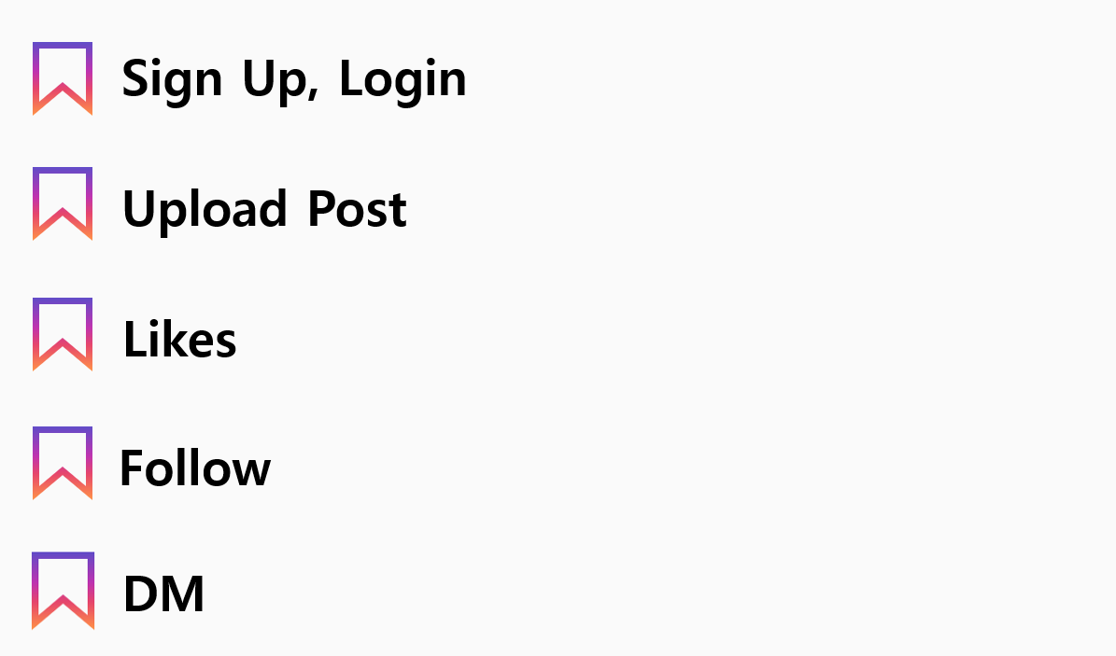
2. StoryLine
1. Sign up
2.Login LogOut
3. Friend management
4. Chatting
5. FILE Transfer…etc

Slide 7
2-1 Sign Up and Connection

Slide 8
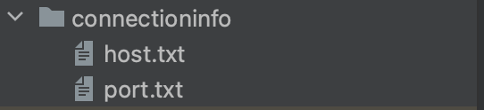
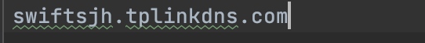
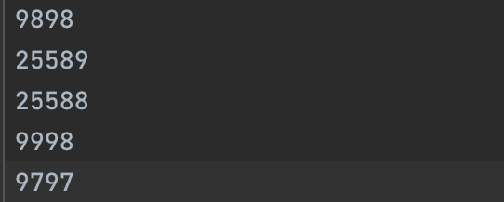
2-1. Server Connection-info

Slide 9

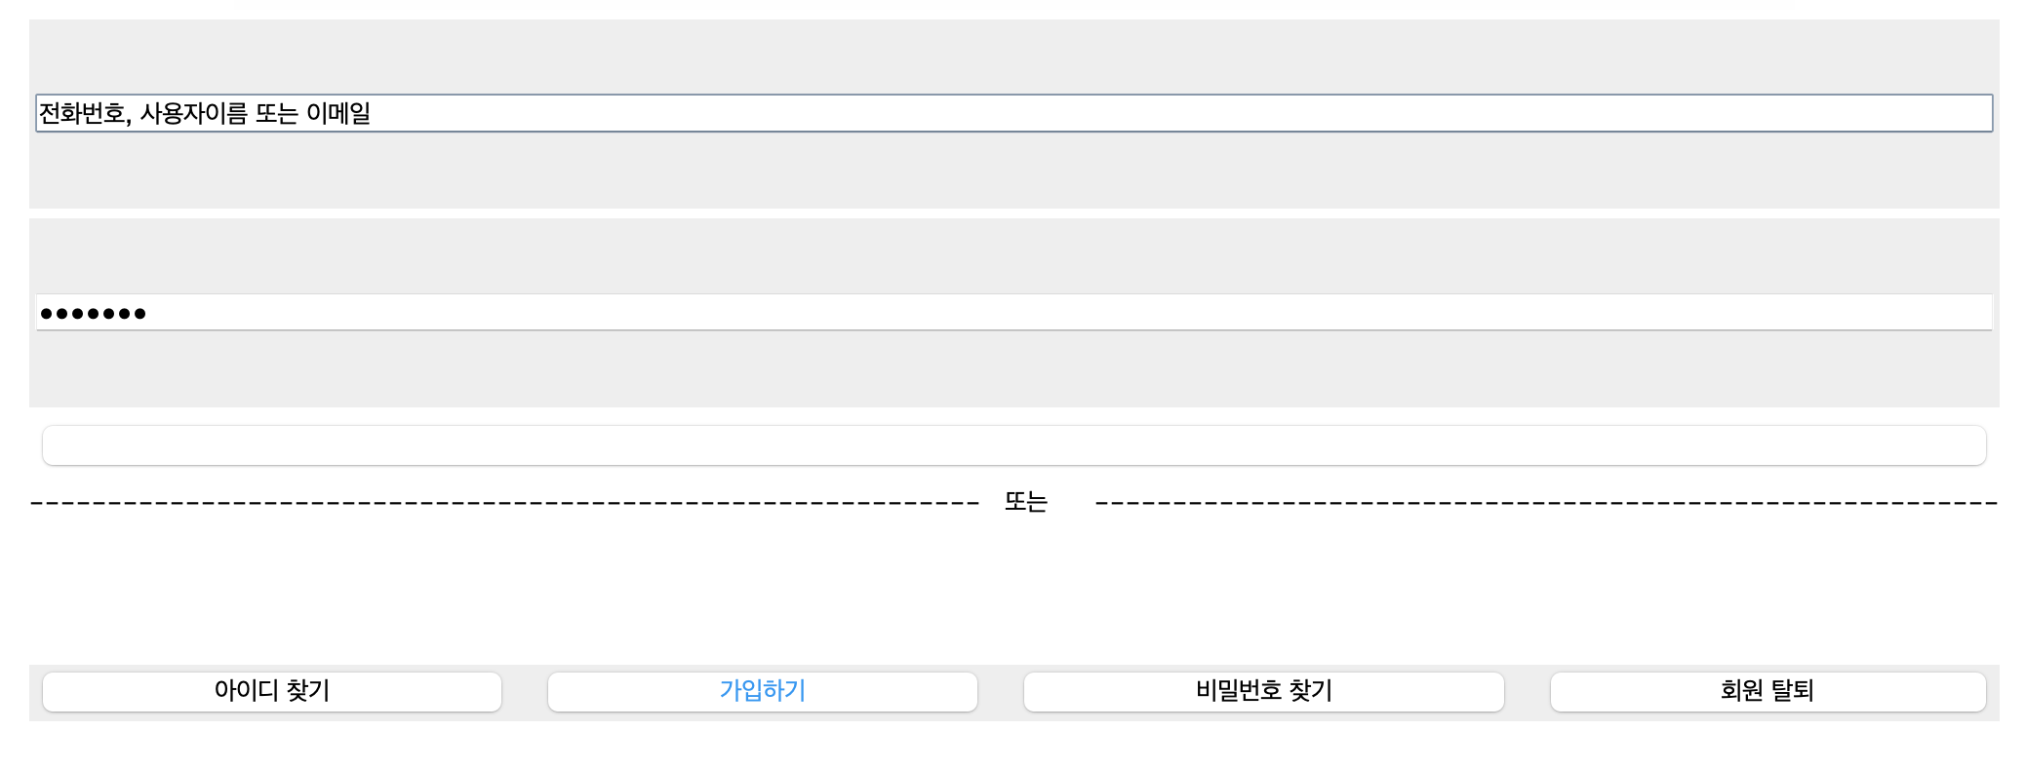
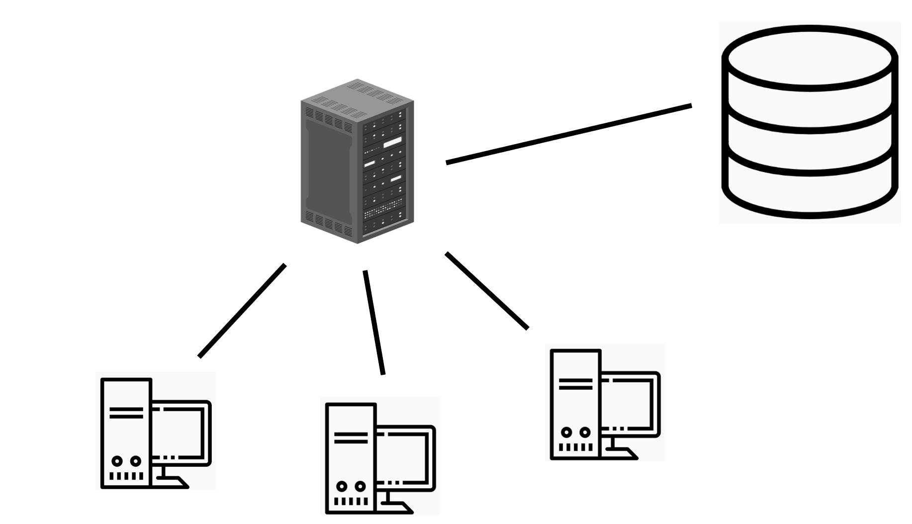
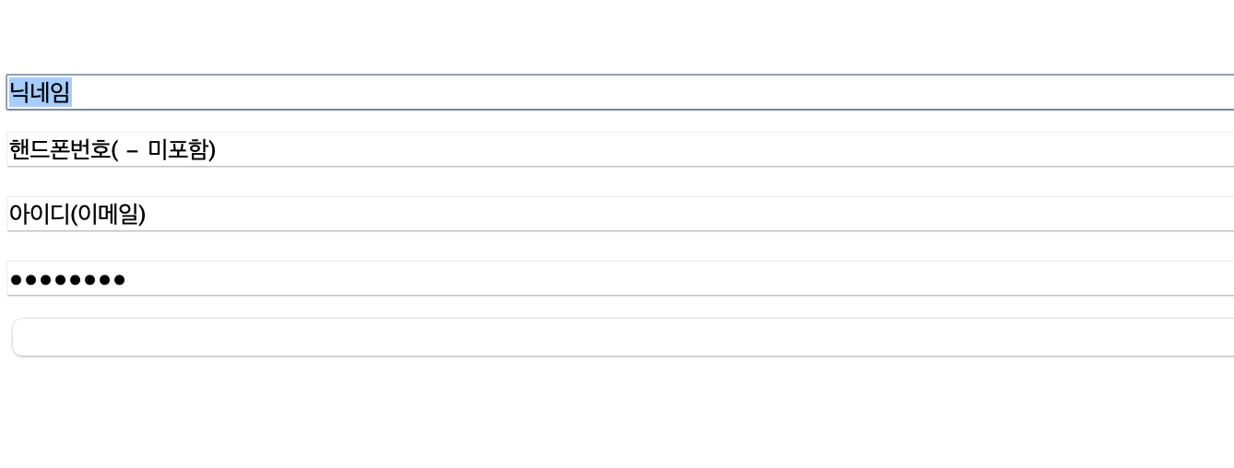
3. Function- Sign Up
1) Sign Up
GUI
Data Flow
INSERT INTO User ….
Port: 9898

Slide 10
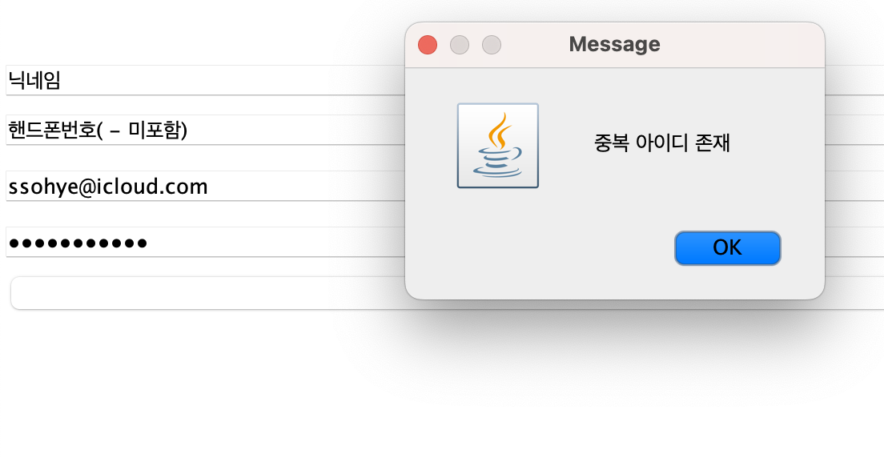
2-1. Function- Sign Up
2) Duplicate ID check
Data Flow
GUI
SELECT email FROM User WHERE email=?;

Slide 11
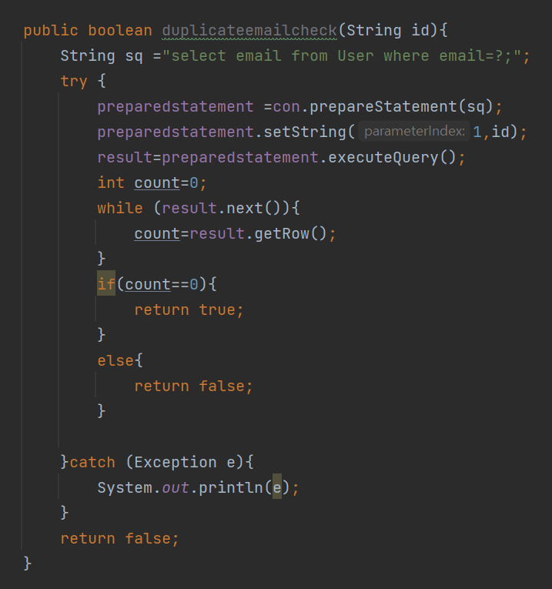
2-1. Function- Sign Up
Reference Code

Slide 12
2-2 LOGIN LogOut

Slide 13
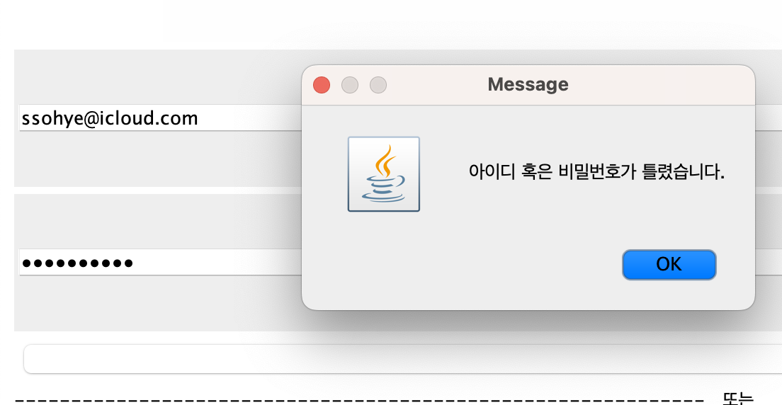
3. Function- Login
1) Login
GUI
Data Flow
SELECT user_id, email, password FROM User;
INSERT INTO online_user(session_id, user_id) VALUE(1,?); //make user online
SELECT session_id FROM online_user WHERE user_id=?; //check if user in online
UPDATE online_user set sessoin_id=1 WHERE user_id=?; //make user online2
When id or pw is wrong

Slide 14
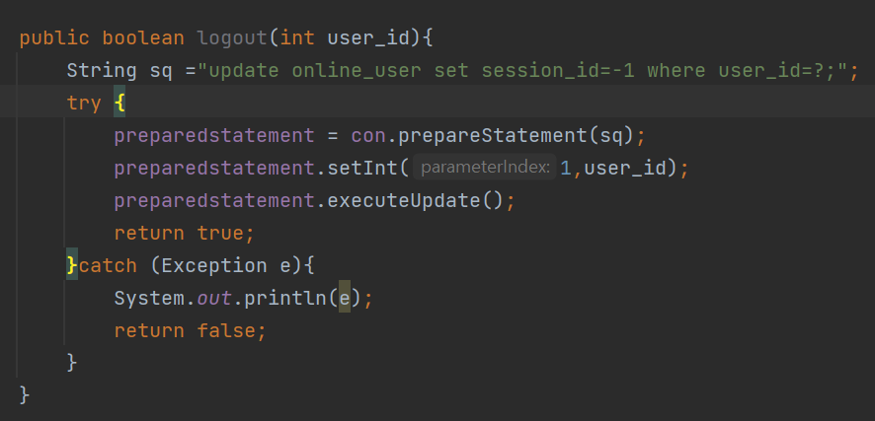
3. Function- Login
2) Log Out
Data Flow
Reference Code
UPDATE online_user set session_id=-1 WHERE user_id=?;
Change Online Status as -1 in Online User Table

Slide 15
2-3 Friend Management

Slide 16
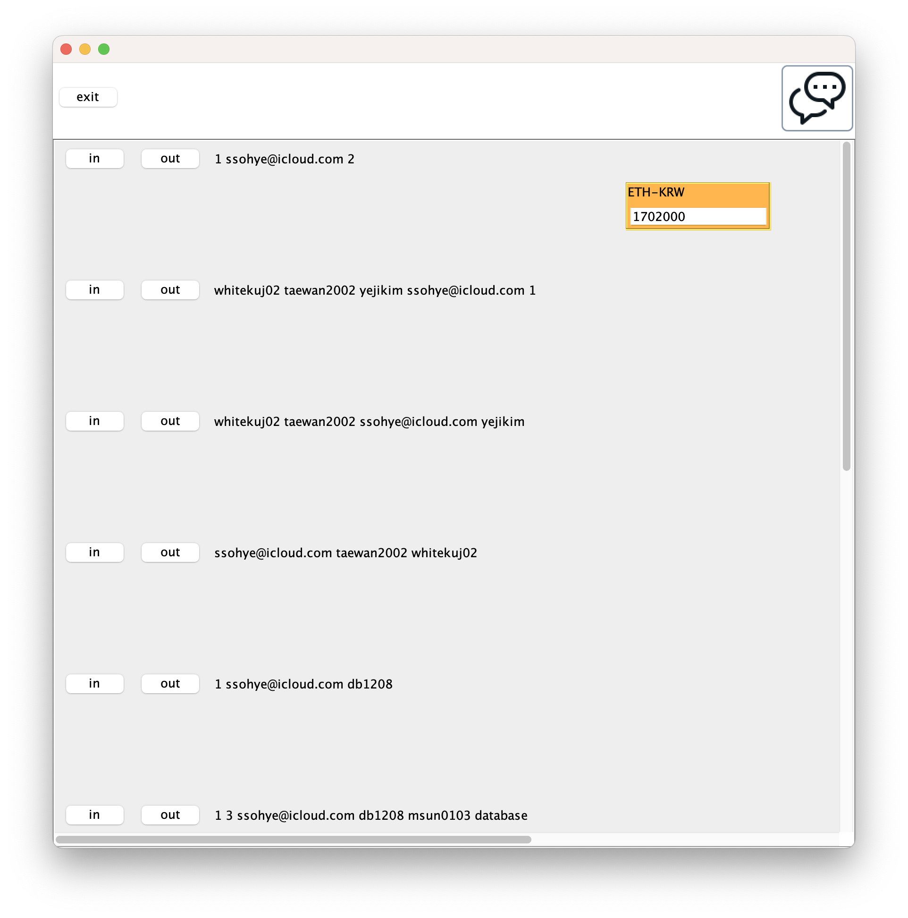
2-3 Fried Management
Menu to make room and add friend
Press in button to enter chatting room
Press out button to leave chatting room
Users in room
Main Screen After Login : chatting room list

Slide 17
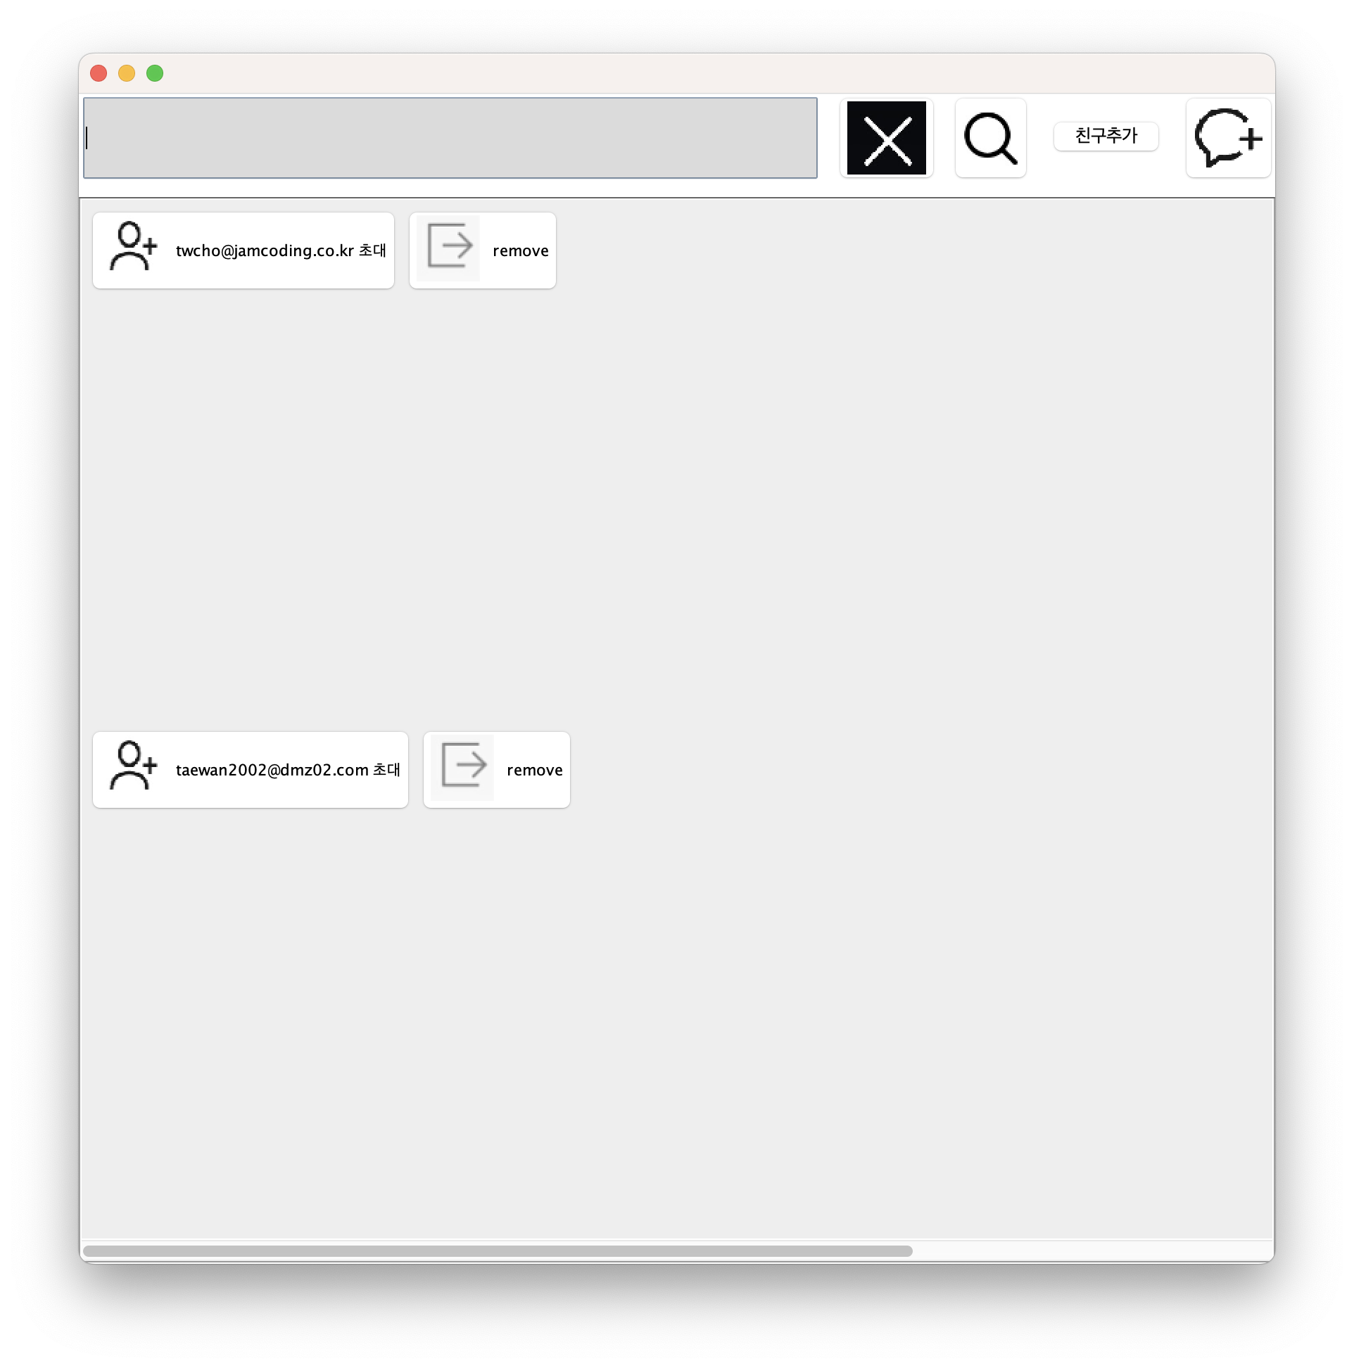
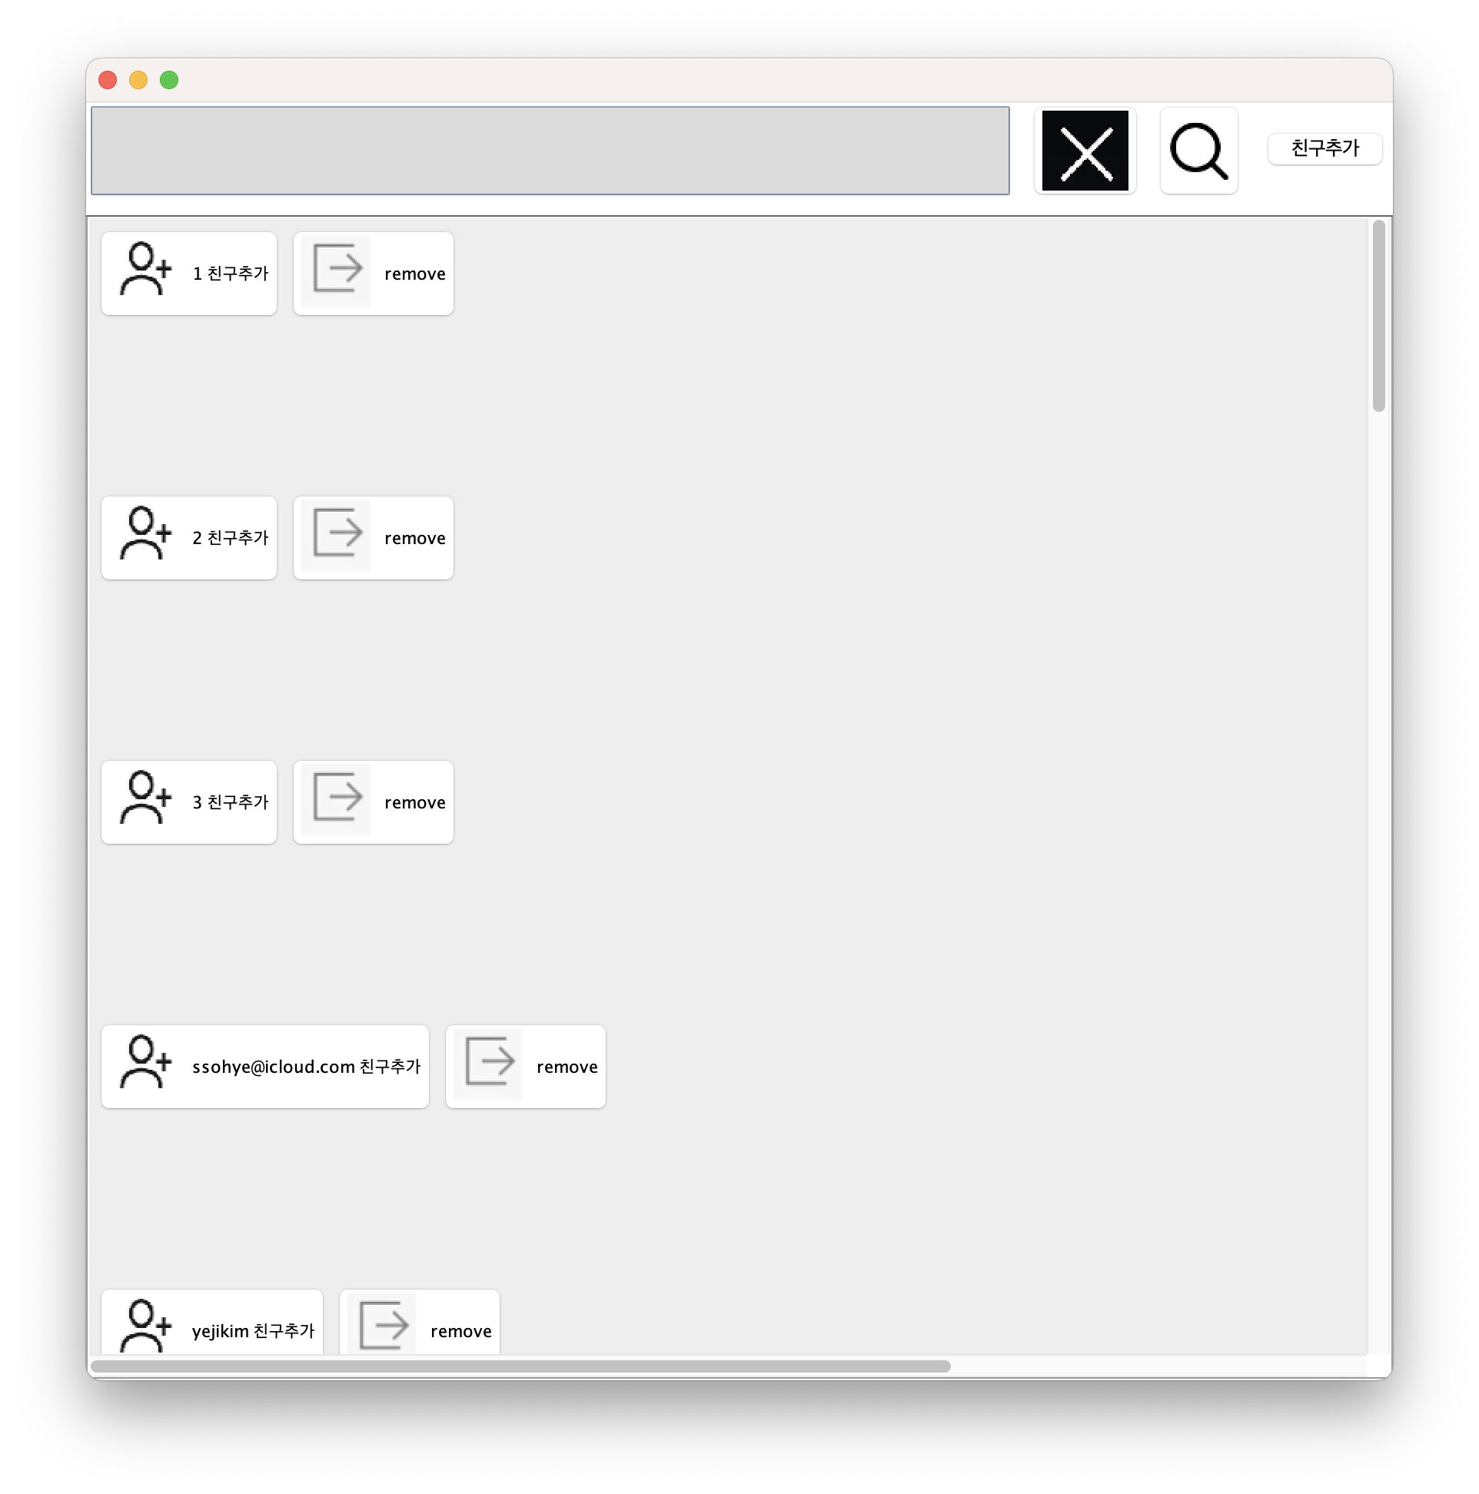
2-3 Fried Management
MY Friend list
Add friend panel

Slide 18
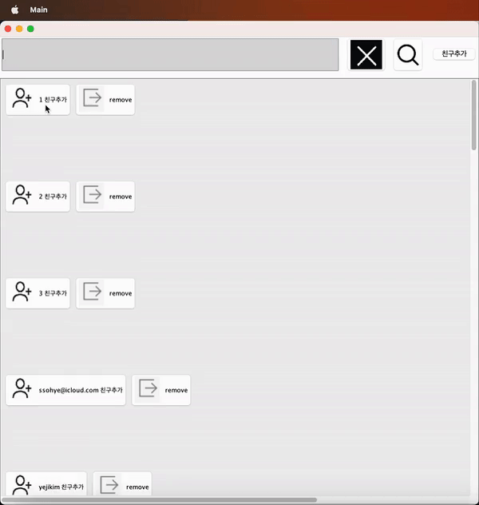
2-3 Fried Management
DEMO VIDEO: ADD FRIEND

Slide 19
2-4 Chatting

Slide 20
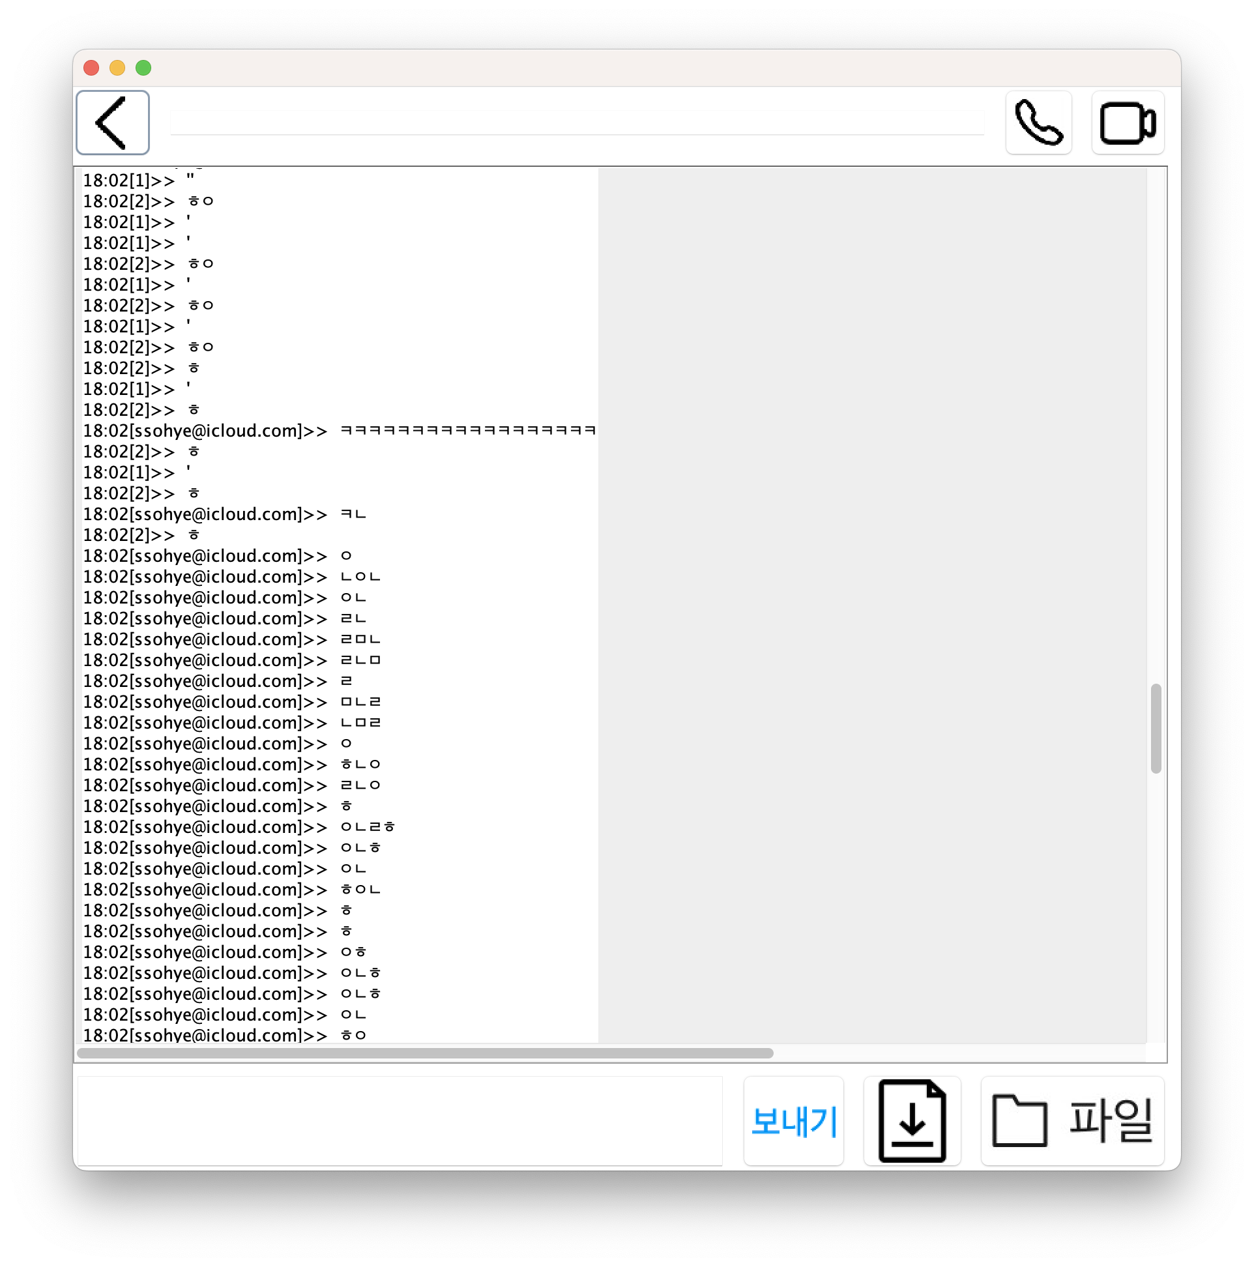
2-4 Chatting
FILE DOWN AND UPLOAD

Slide 21
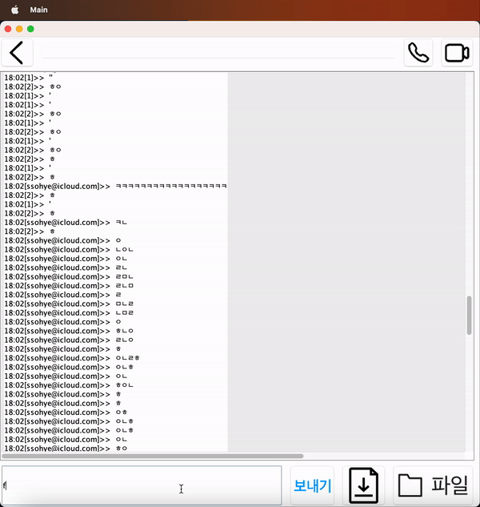
2-4 chatting
DEMO VIDEO: CHATTING

Slide 22
2-5 FileTransfer.. ETC

Slide 23
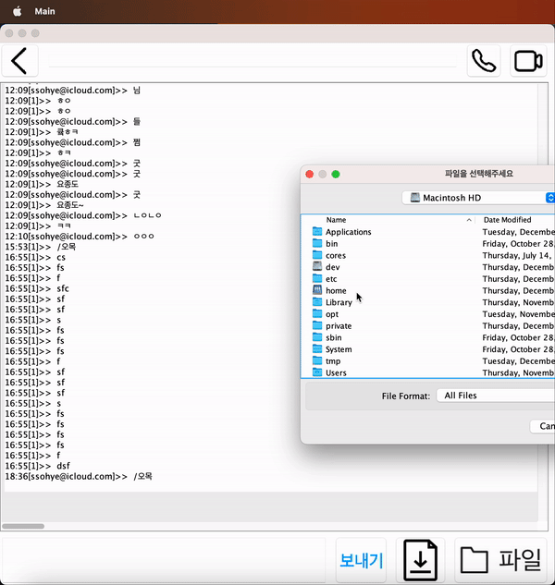
2-5 File Transfer ..etc
DEMO VIDEO: FILE UPLOAD

Slide 24
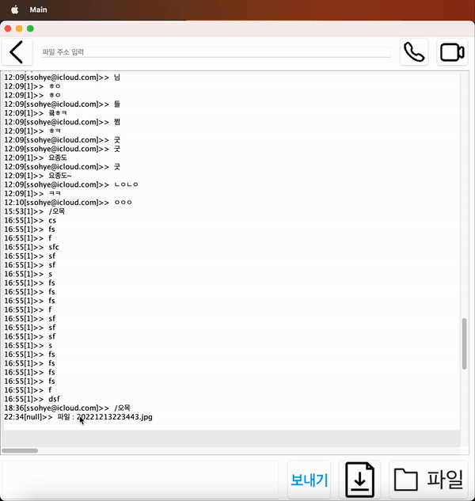
2-5 File Transfer ..etc
DEMO VIDEO: FILE DOWNLOAD

Slide 25
2-5 File Transfer ..etc
Etherium Crypto currency :
Powered by REST API of UPBIT
(JSON)

Slide 26
3. Reference(OpenSource)

Slide 27
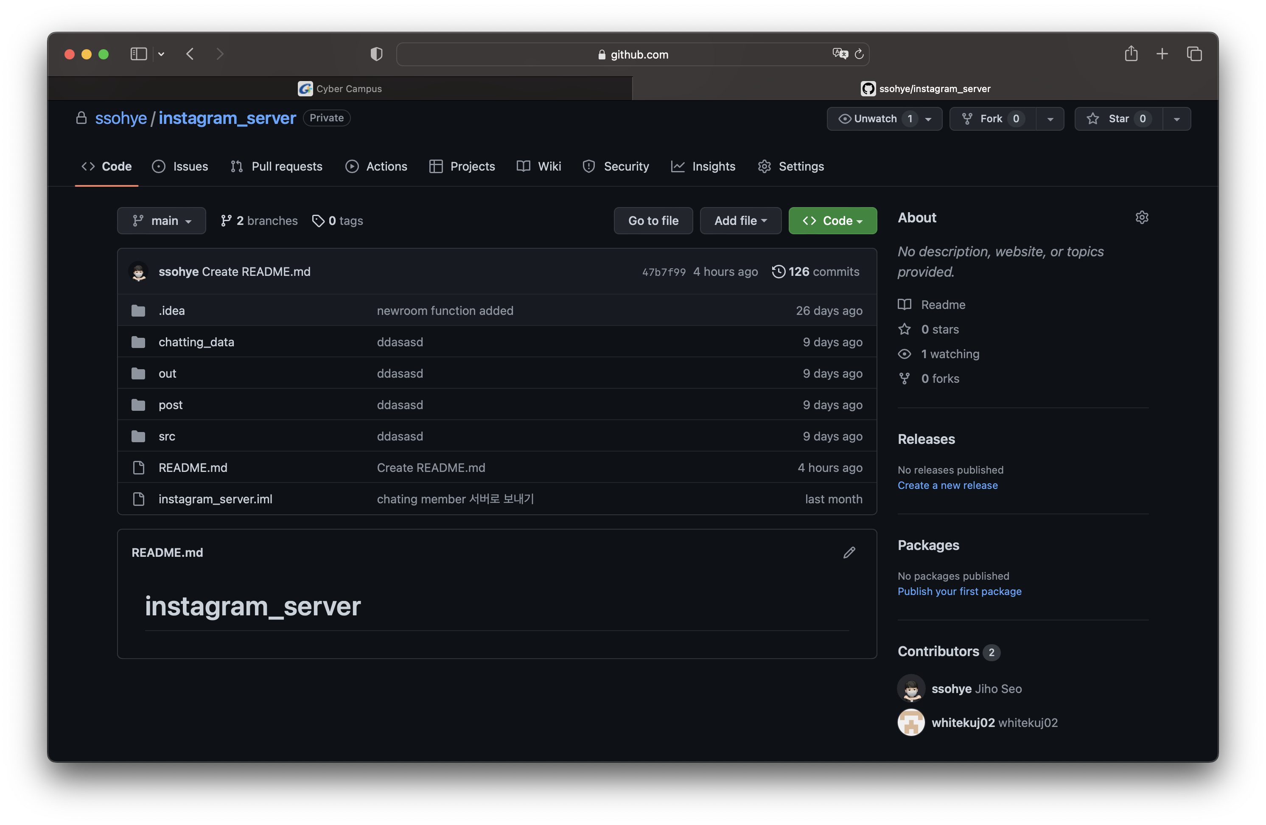
Referenced OpenSource:
https://github.com/ssohye/instagram_server
Author ->
1: taewan2002@dmz02.com
2: swiftsjh02@dmz02.com
3. whitekuj02@dmz02.com

Slide 28
Thank you
로그아웃

